Slide 1
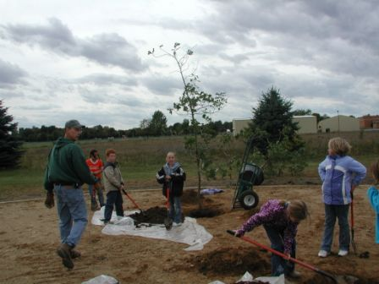
2003 & 2004 Sylvester Elementary – Berrien County
A ½ acre prairie using native grasses, wildflowers, and shrubs on school’s playground. Students, teachers, and volunteers help plant the prairie. Since then the prairie has matured & become part of our school campus.

Slide 2
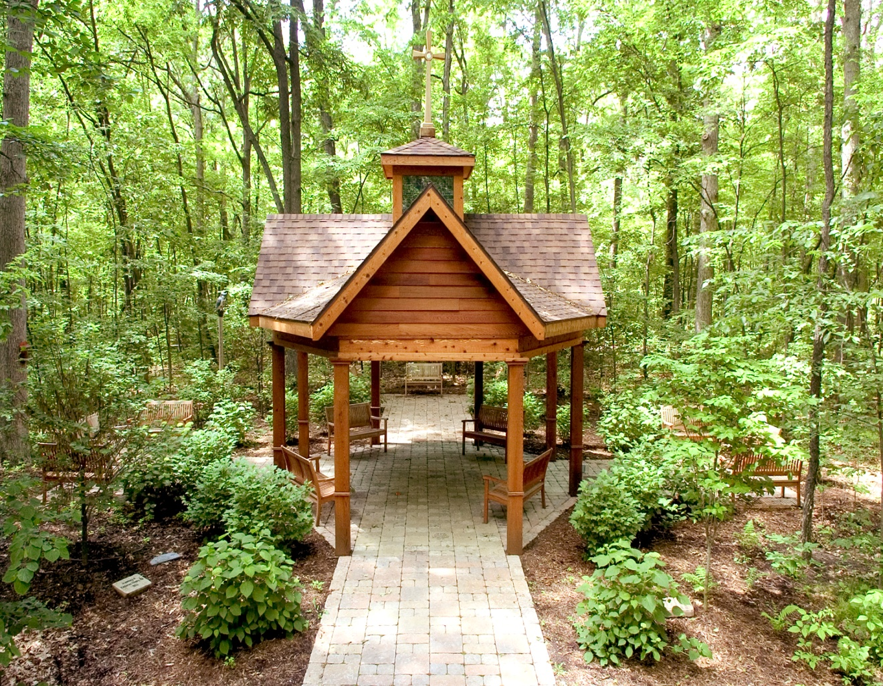
2006 - Genesys Regional Med Ctr – Sanctuary Garden
Located just off the Heron Walking Trail at Genesys Health Park, the flora of the garden includes native Michigan wildflowers, trees and shrubs, with all man-made enhancements constructed out of natural woods and stones. 50 to 75 people walk area daily.

Slide 3
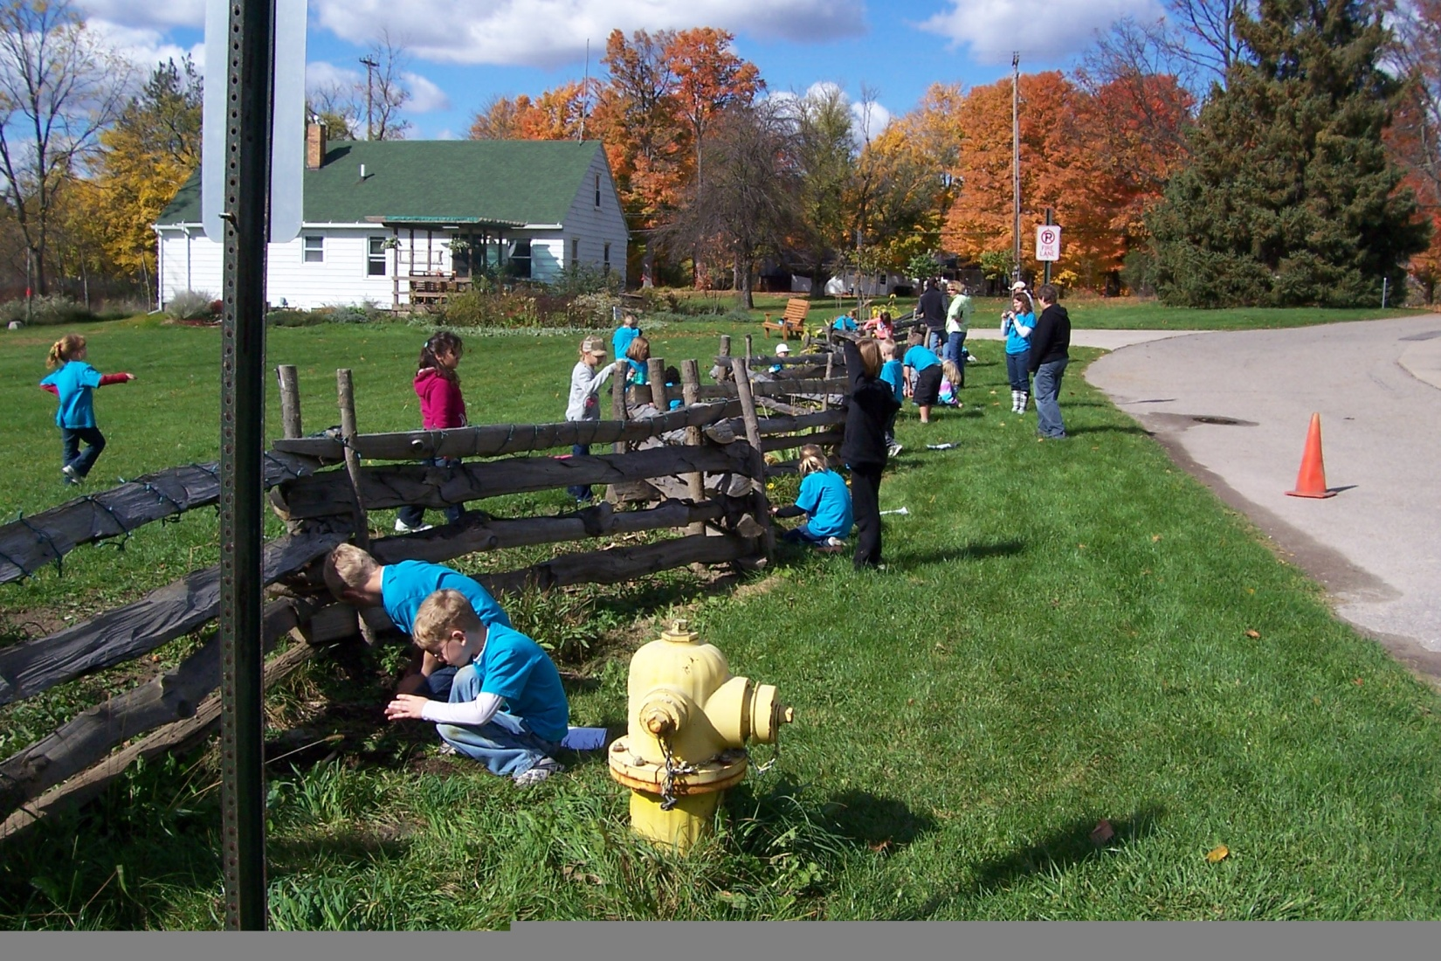
2011-Woldumar Nature Center
Ingham County
Insect count

Slide 4
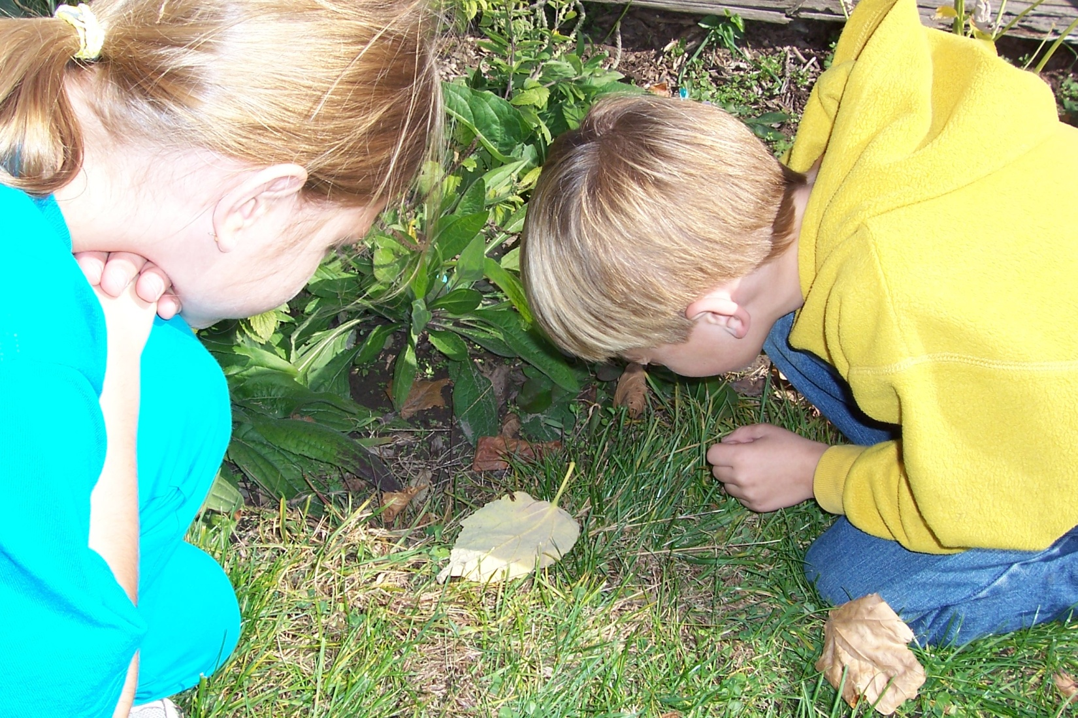
2011-Woldumar Nature Center
Insect Study

Slide 5
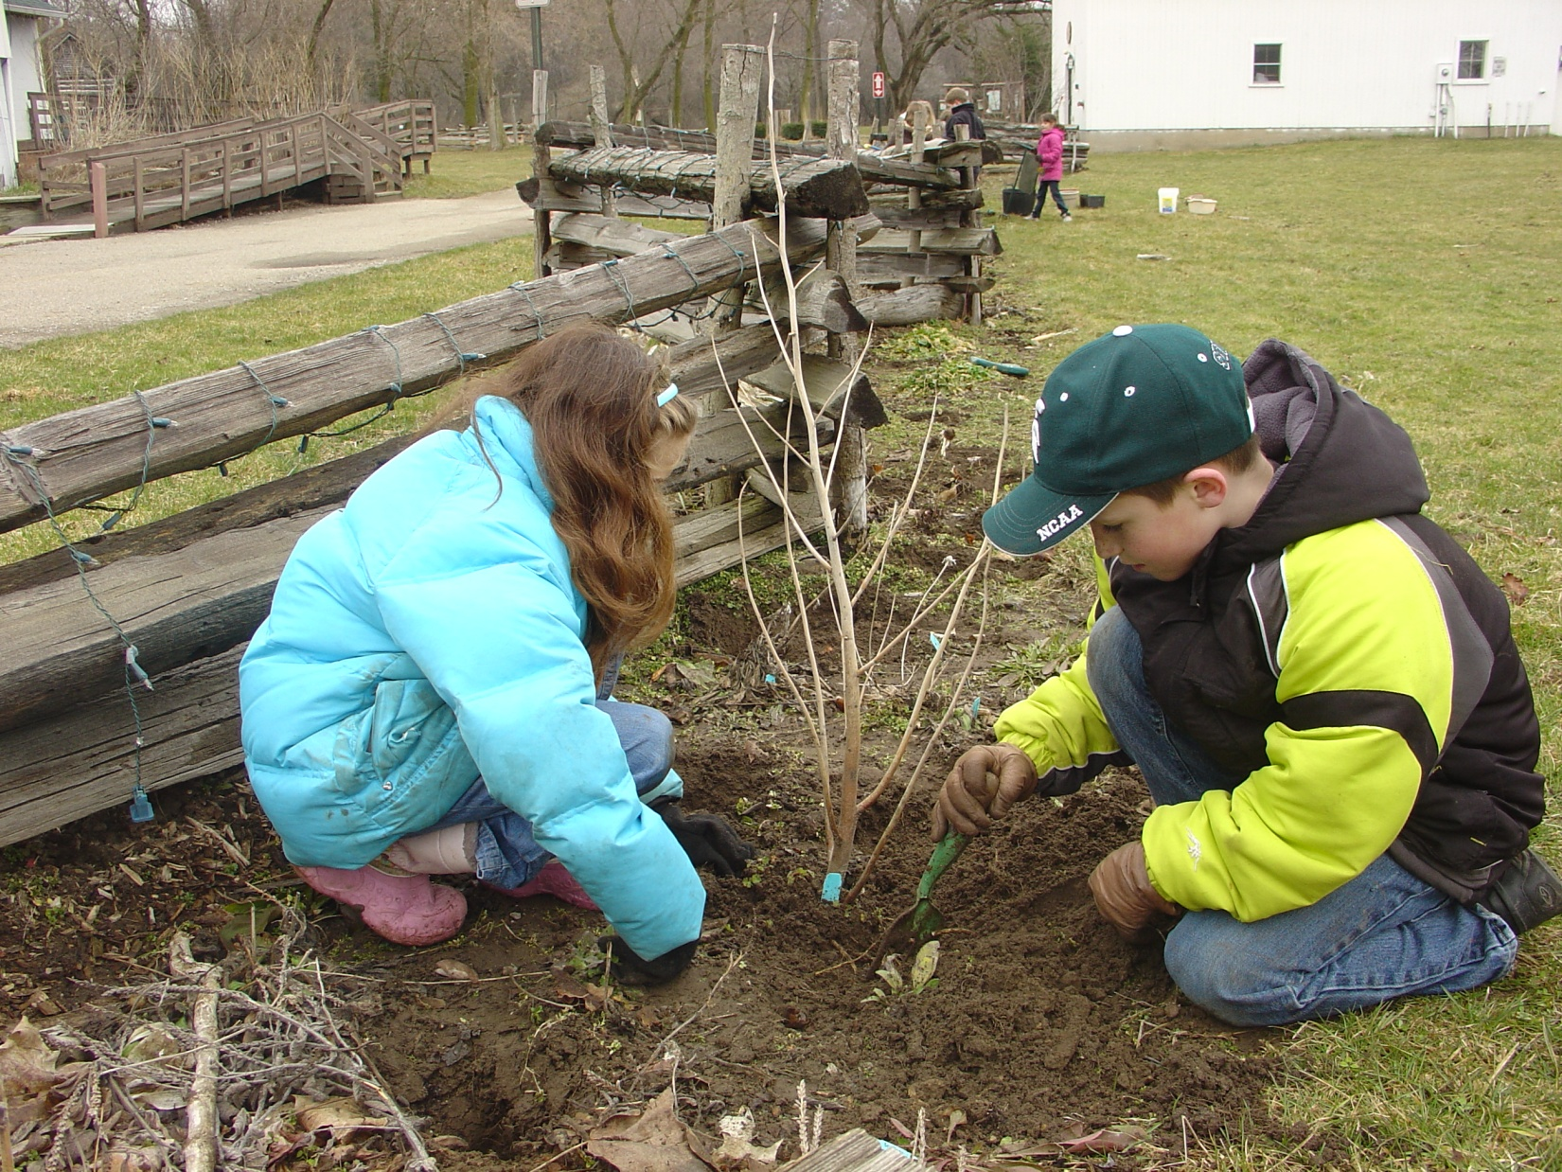
2011-Woldumar Nature Center
Transplanting

Slide 6
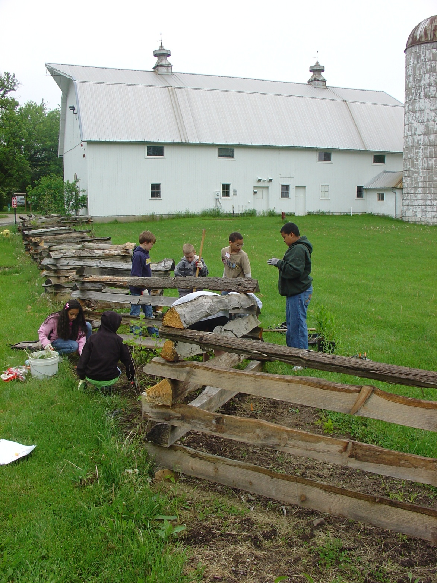
2011-Woldumar Nature Center
Students Planting

Slide 7
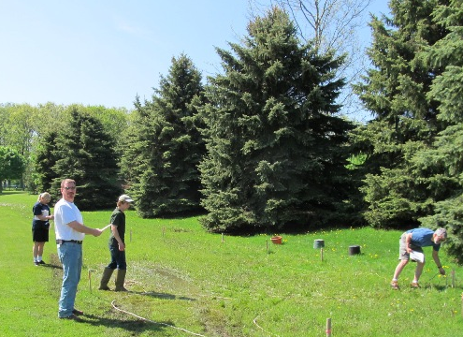
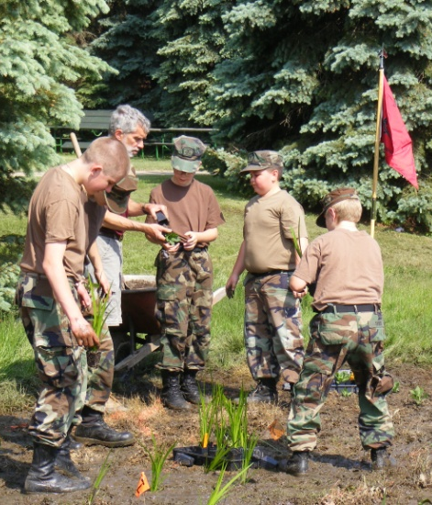
Rain Garden Installation, June 2011
Left: Laurie Kaufman, Pat Witte, Nicholas Sanchez, & Jim Hewitt lay out the garden contours.
Center and below: Laurie, Jim, and Nick work with the Navy League Cadet Corps to plant the rain garden.

Slide 8
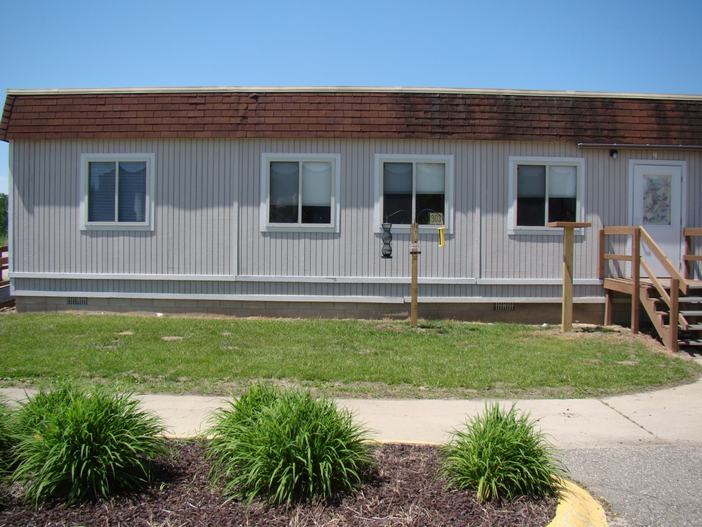
2011 Saginaw/Chippewa Academy
Before we started

Slide 9
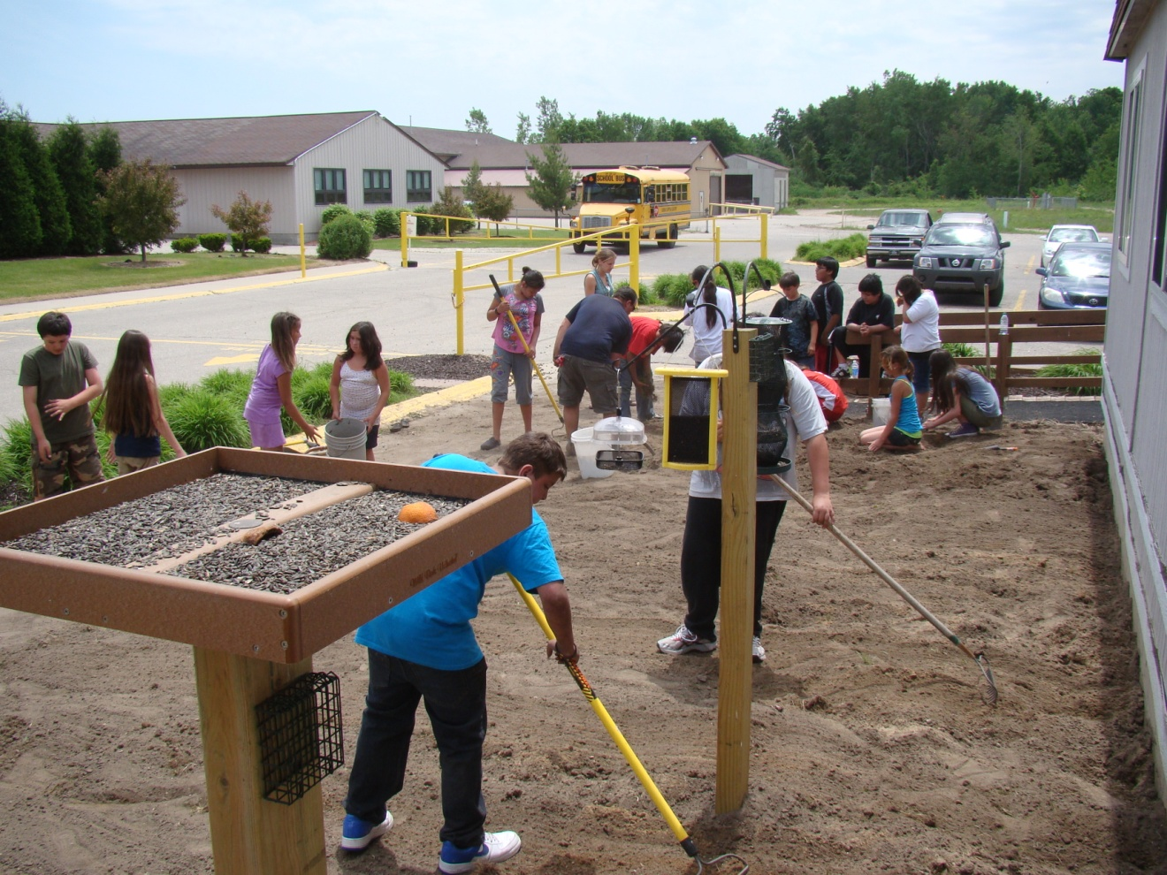
2011 Saginaw/Chippewa Academy
Preparing the Site

Slide 10
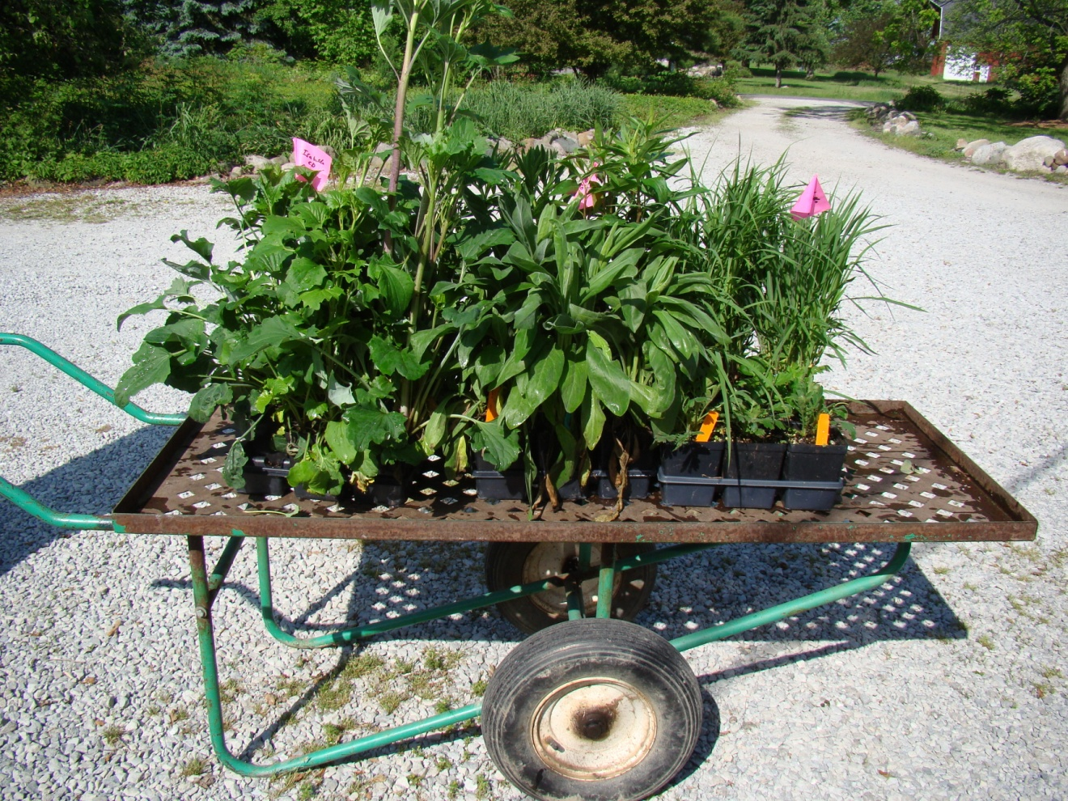
2011 Saginaw/Chippewa Academy
Plants Purchased

Slide 11
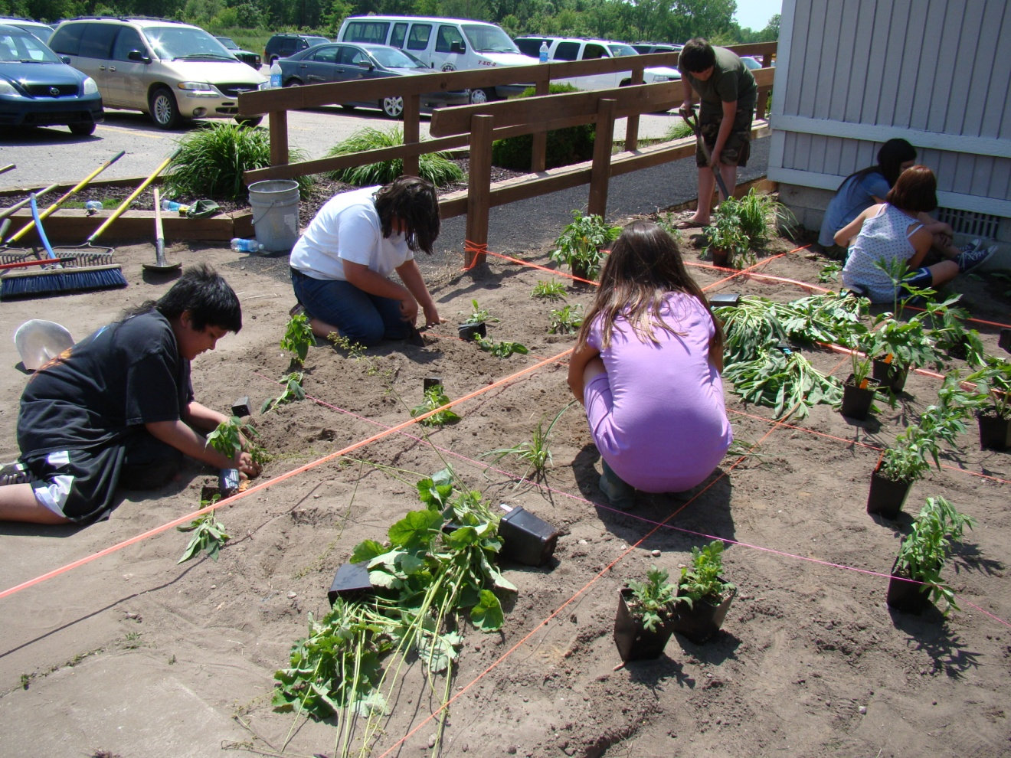
2011 Saginaw/Chippewa Academy
Planting

Slide 12
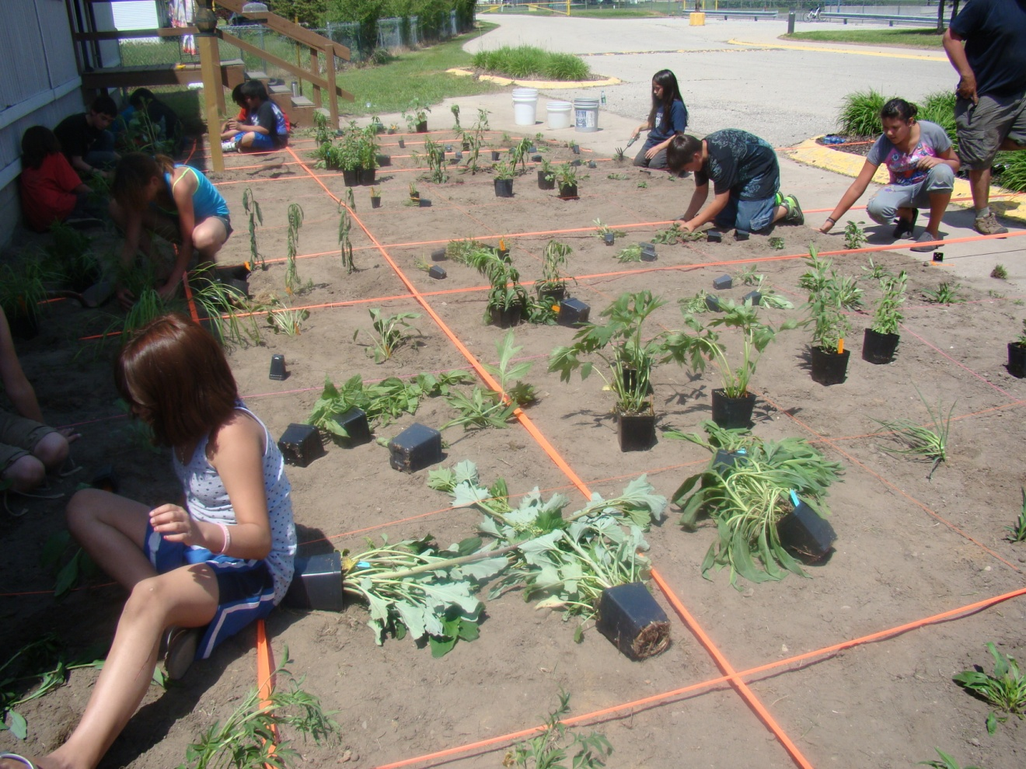
2011 Saginaw/Chippewa Academy
More Planting

Slide 13
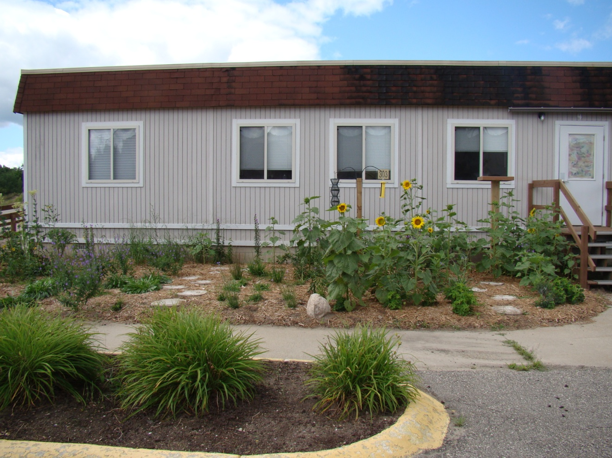
2011 Saginaw/Chippewa Academy
During Summer

Slide 14
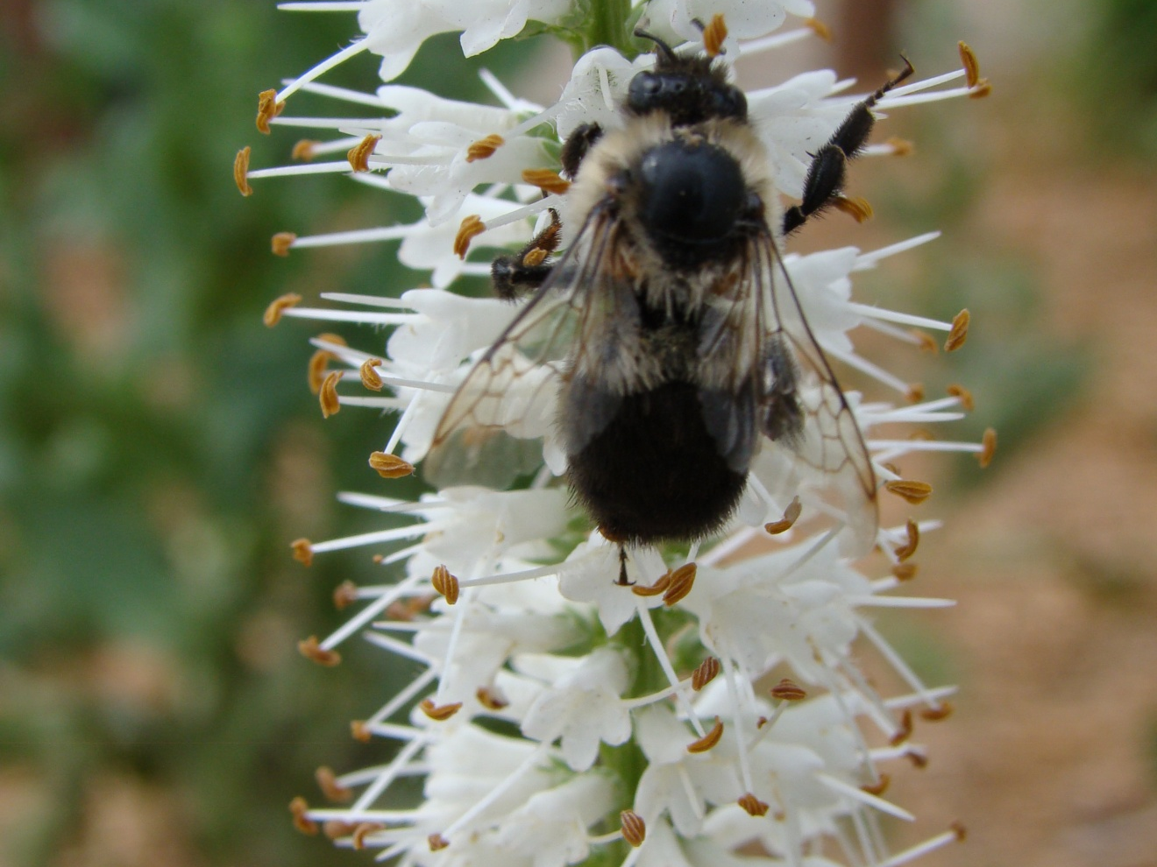
2011 Saginaw/Chippewa Academy
Pollinator Visits

Slide 15
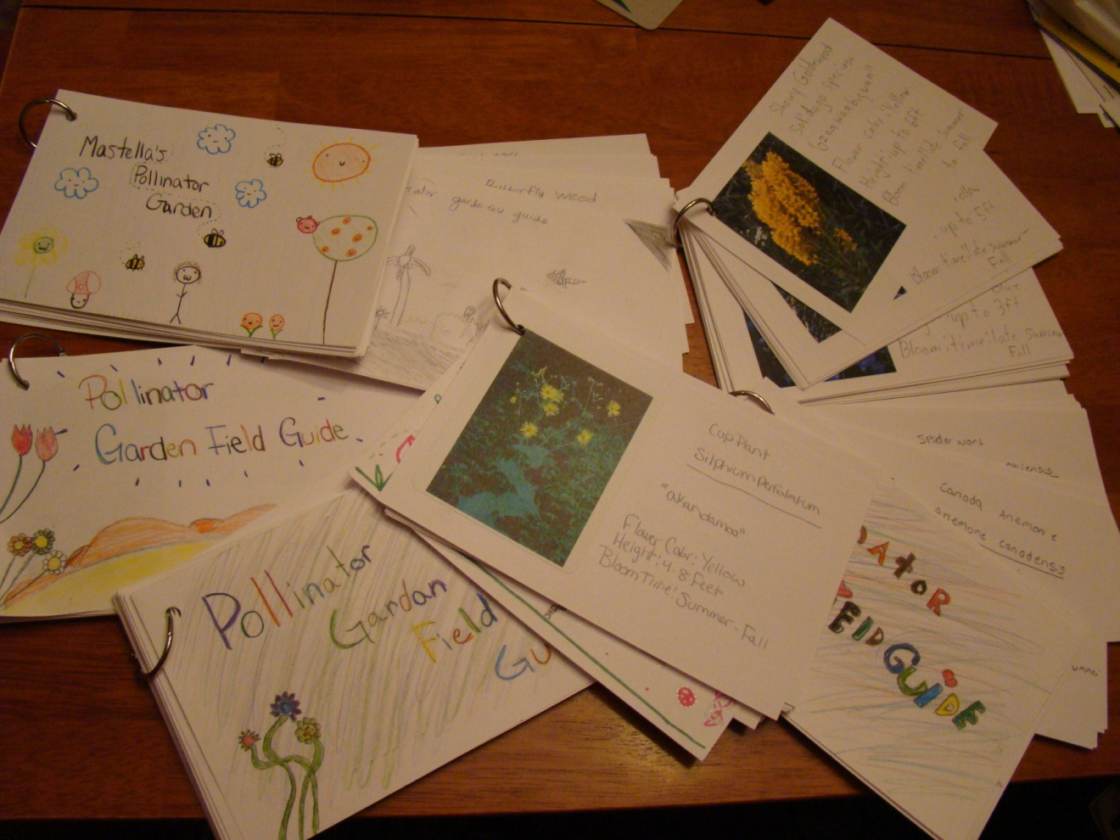
2011 Saginaw/Chippewa Academy
Pollinator Field Guides by Students

Slide 16
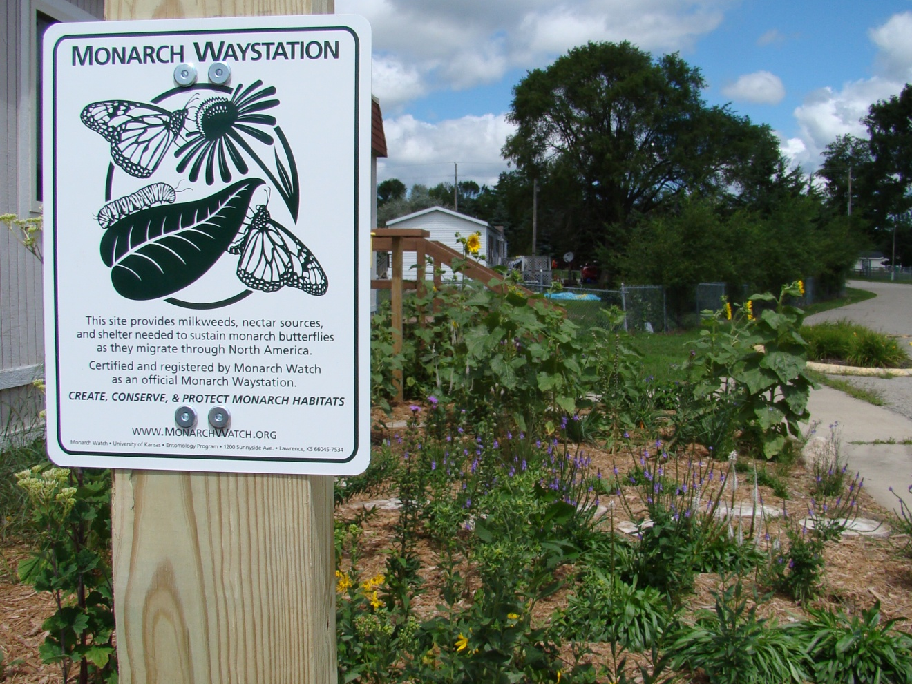
2011 Saginaw/Chippewa Academy
Becoming a Monarch Waystation

Slide 17
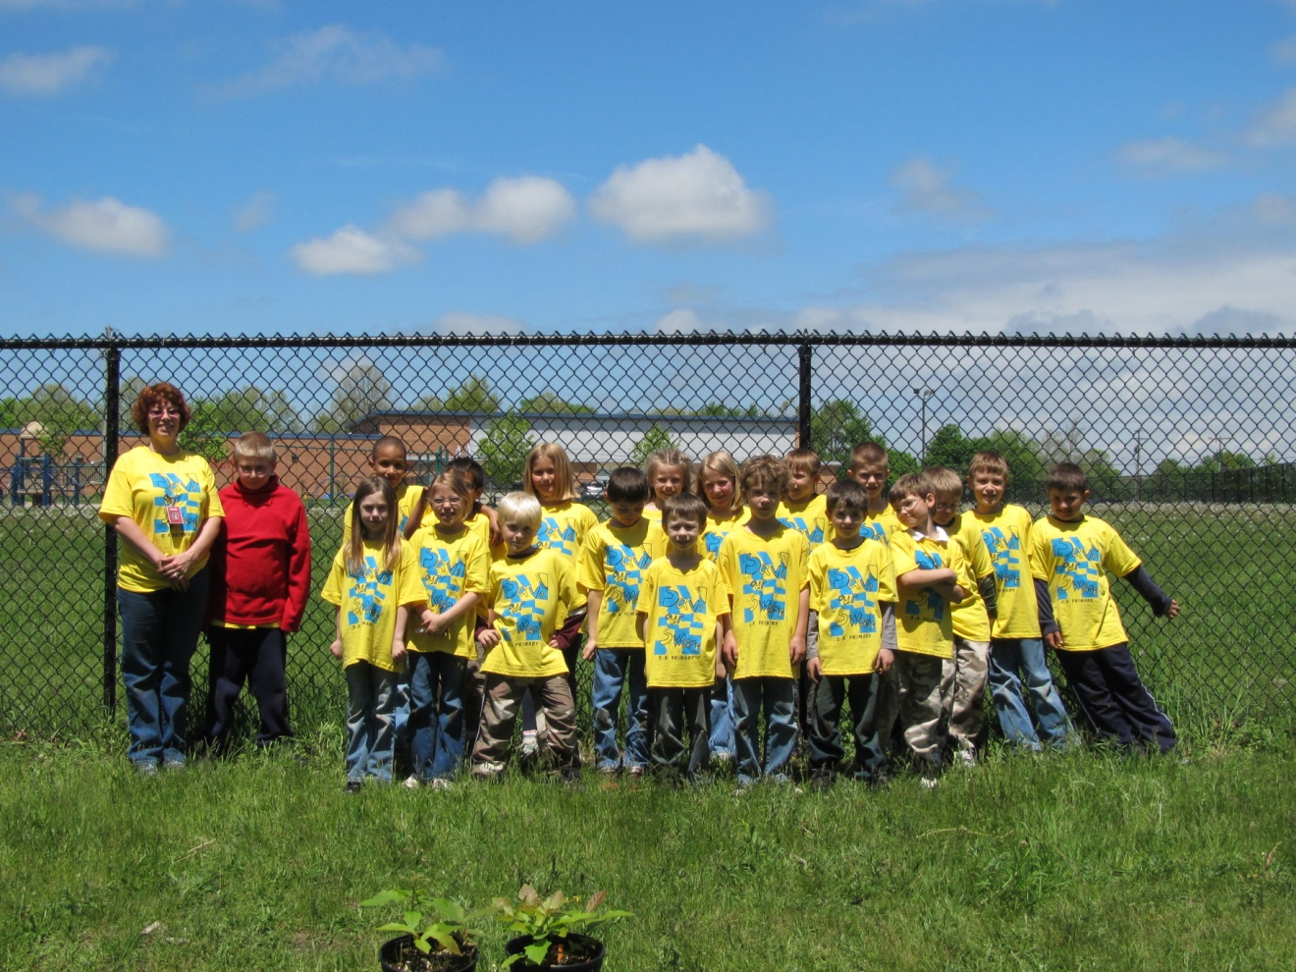
2011 Galesburg-Augusta Elementary
Ready to Go!

Slide 18
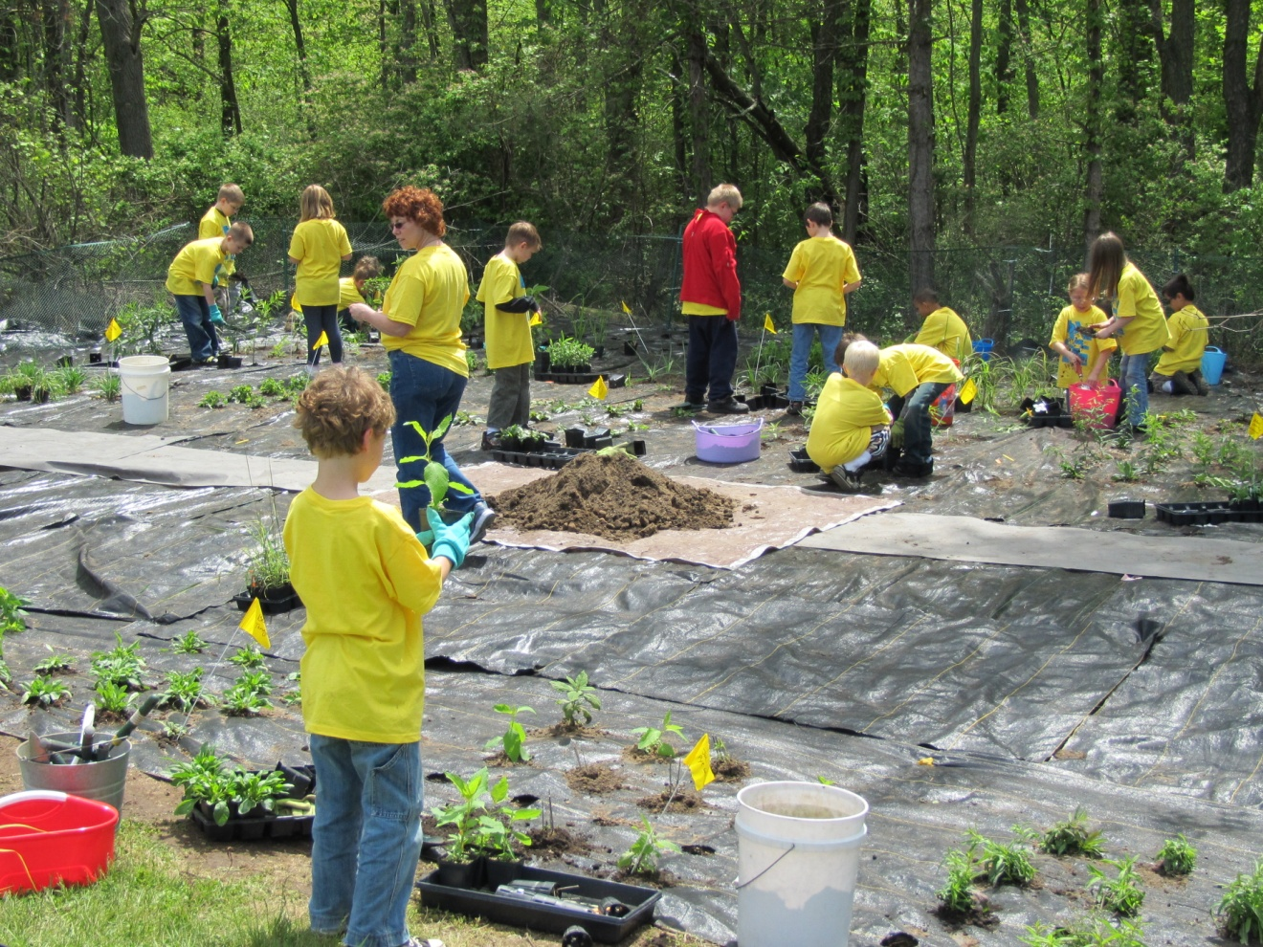
2011 Galesburg-Augusta Elementary
Kalamazoo County
Lots of Helpers!

Slide 19
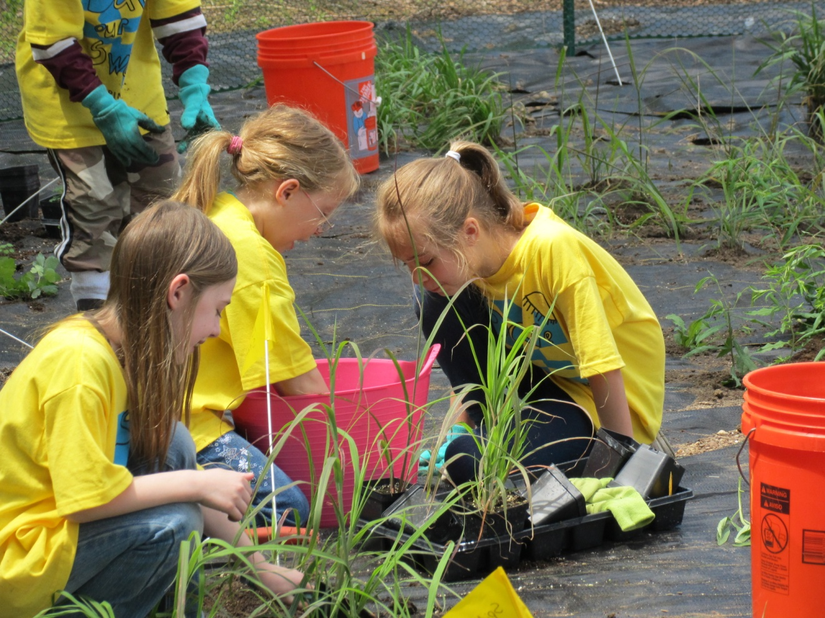
2011 Galesburg-Augusta Elementary
Planting Day

Slide 20
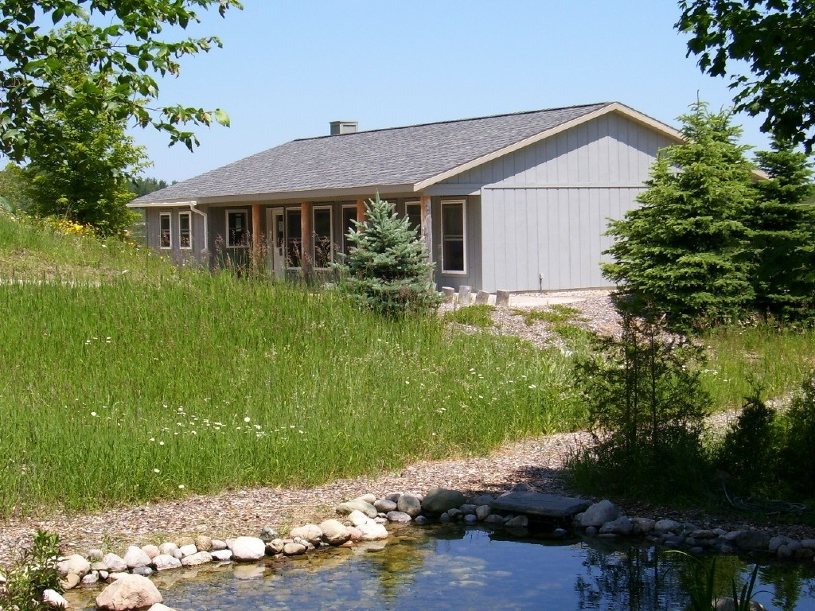
2005/2006 Saving Birds Thru Habitat
Leelanau County
Plants for our prairie garden, which is on the hill above the nature center (to the west -- left -- of the elm tree in the photo of our building).

Slide 21
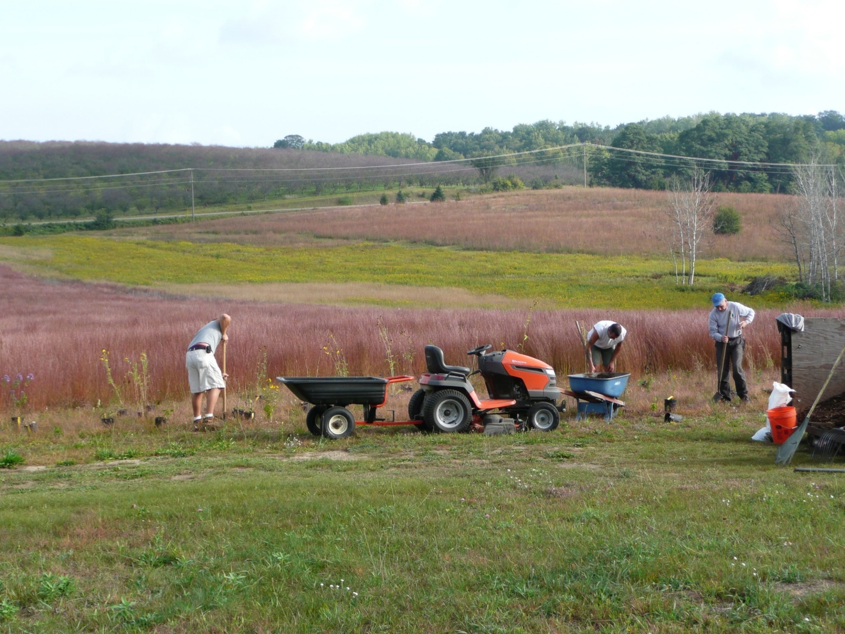
2005/2006 Saving Birds Thru Habitat
Each year we host hundreds of school children on field trips. Our average annual visitation by people of all ages is between a thousand and fifteen hundred individuals.

Slide 22
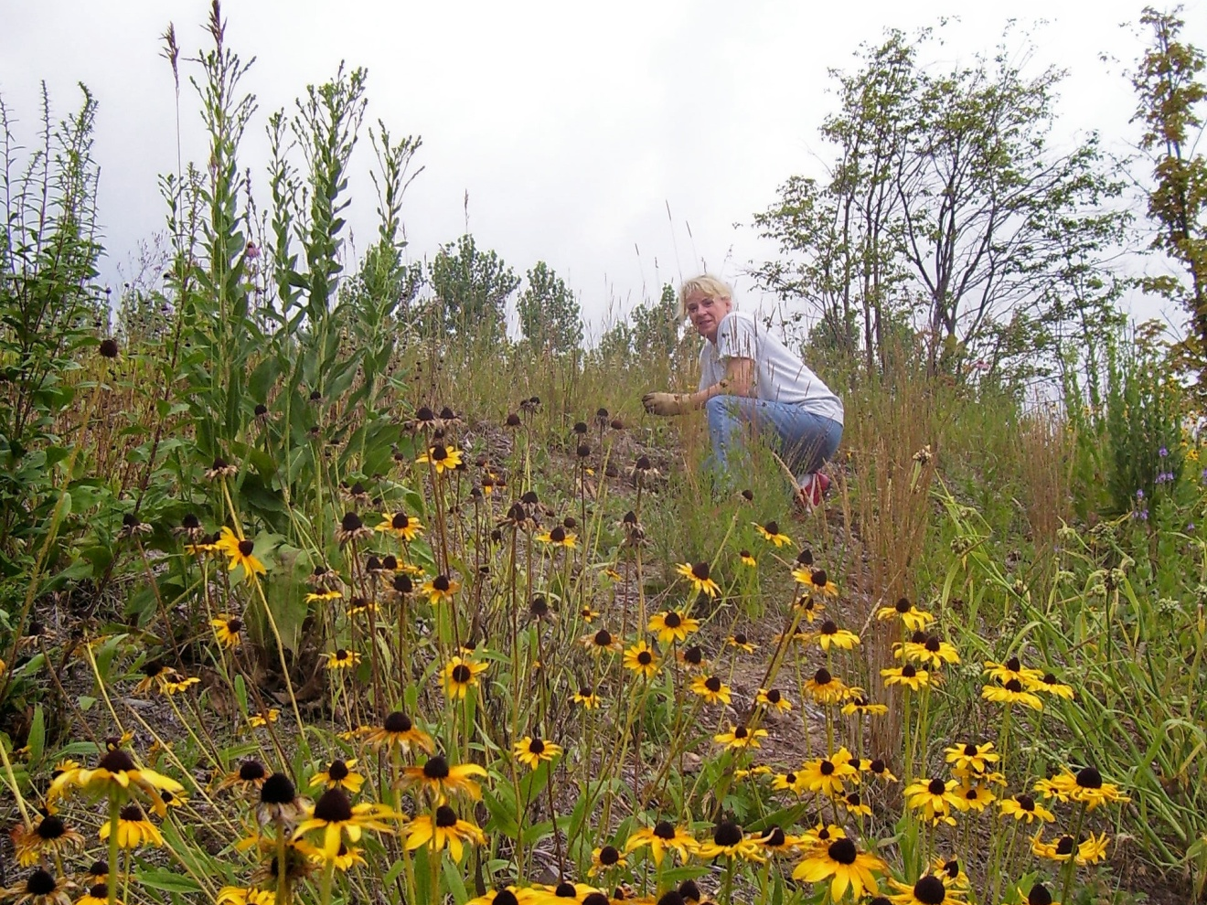
2005/2006 Saving Birds Thru Habitat
Inspired: installation of a 20 acre prairie on a sand mine in Wexford County . Grand Traverse Regional Land Conservancy to embark on a 350 acre prairie project in Benzie County. Two private property owners in Leelanau County to install native plant meadows in their large personal landscapes.

Slide 23
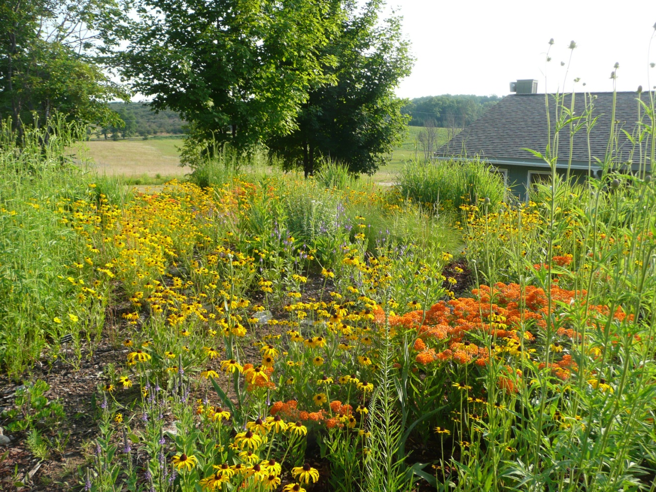
2005/2006 Saving Birds Thru Habitat
Our main efforts focus around persuading people to incorporate natives in their personal landscapes. Our goal with the prairie garden is to demonstrate the beauty of our native flora.

Slide 24
2005/2006 Saving Birds Thru Habitat
Plants for the water feature; you can see in that photo columbine and a Joe-pye stalk leaning over the left side of the waterfall.

Slide 25
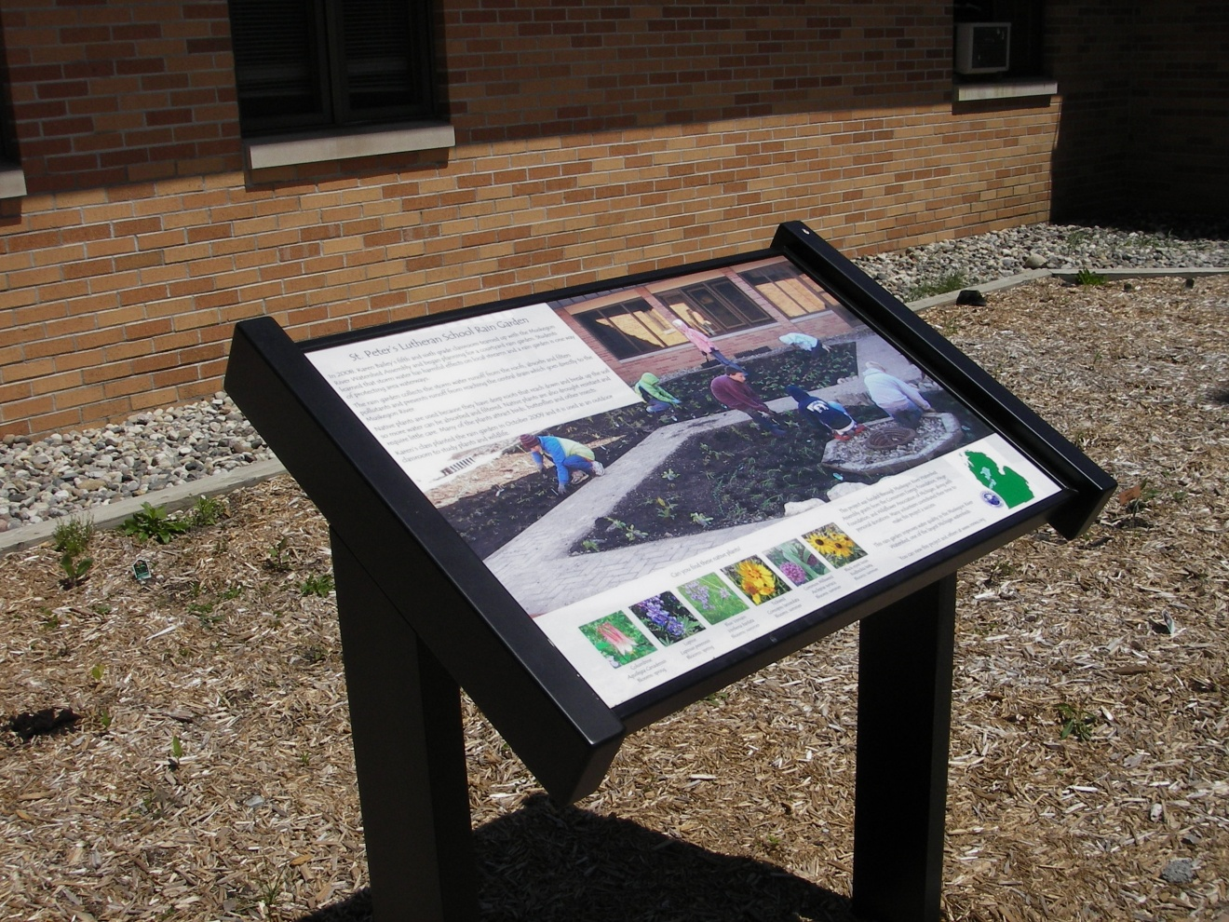
Muskegon River Watershed Assembly
Mecosta County
The St. Peter's Courtyard Rain and Butterfly Garden Outdoor Classroom project was the MRWA first rain garden. It improves water quality in the Muskegon River by collecting storm water runoff from the school's roof and absorbing it before it enters a drain that directly flows to the Muskegon River.

Slide 26
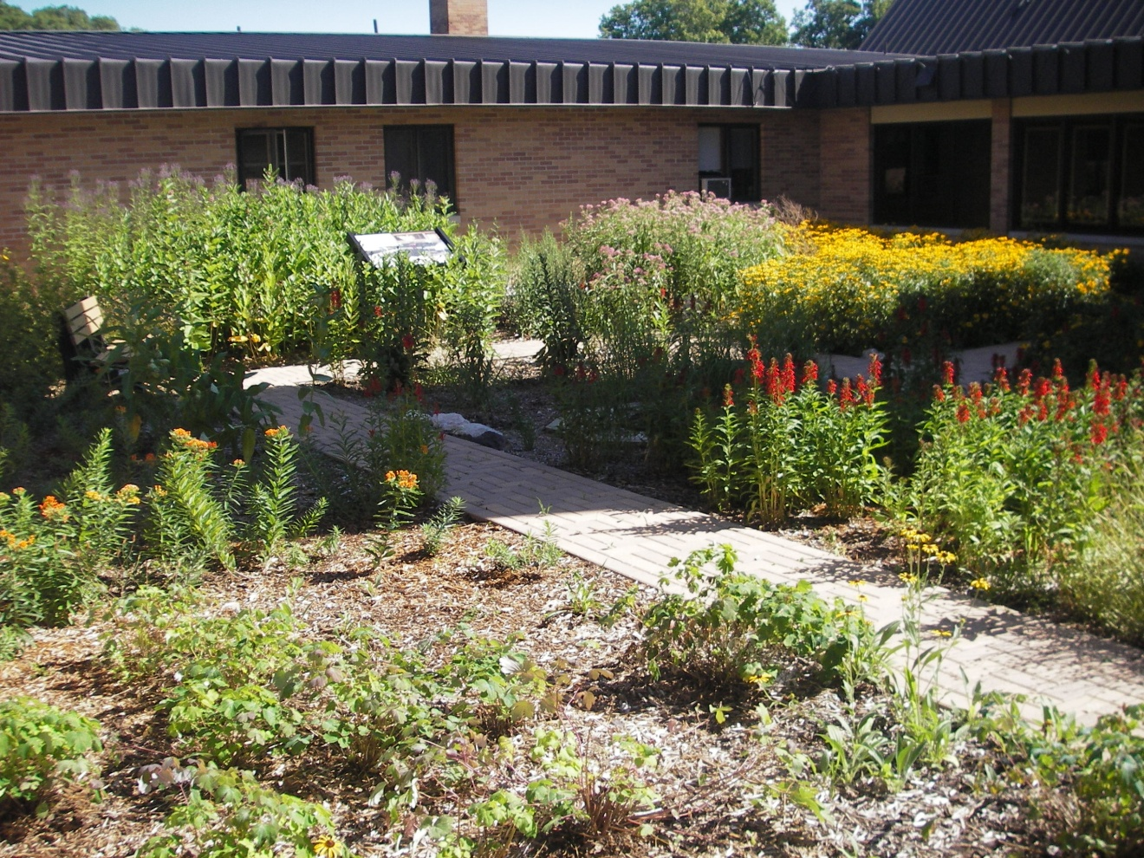
Muskegon River Watershed Assembly
The project provides outdoor classroom for students to satisfy many State of MI mandated science content expectations. Students take home what they learned and encourage their parents to do similar projects with native plants. MRWA has since completed several other rain gardens .

Slide 27
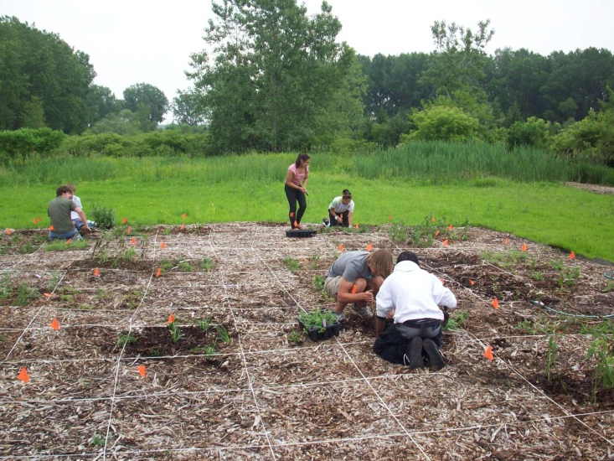
2009 - Monroe Public Schools
Monroe County
A garden with over 60 species of native prairie at Knabusch Mathematics and Science Center (formerly Bolles Harbor Mathematics and Science Center). Students utilize the garden for a variety of lessons, as well as collecting seeds and growing plants from these seeds.

Slide 28
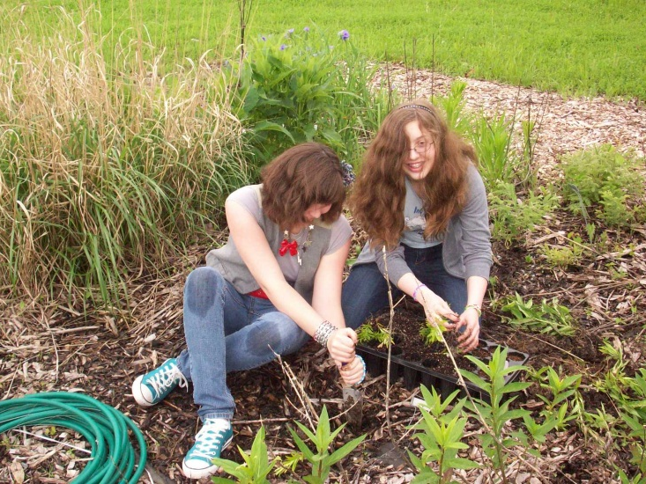
2009 - Monroe Public Schools
The main audience are the high school students enrolled in courses at the Center. Five school years worth of students have benefited from the project. This amounts to over 300 students total. Other audiences, such as elementary school students, have benefited from the project as well.

Slide 29
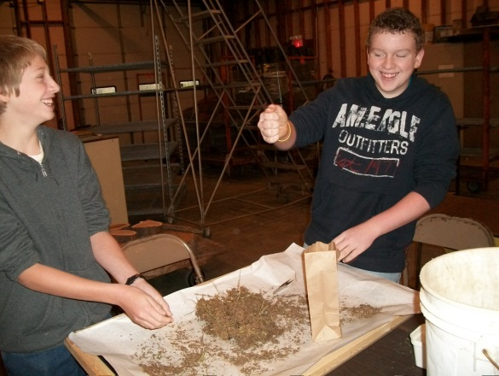
2009 - Monroe Public Schools
Building the garden is now complete. It took over 5 years and nearly 20 different organizations and donors to help with the funding. Including other restoration projects on campus, over $10,000 has been used directly on the project.

Slide 30
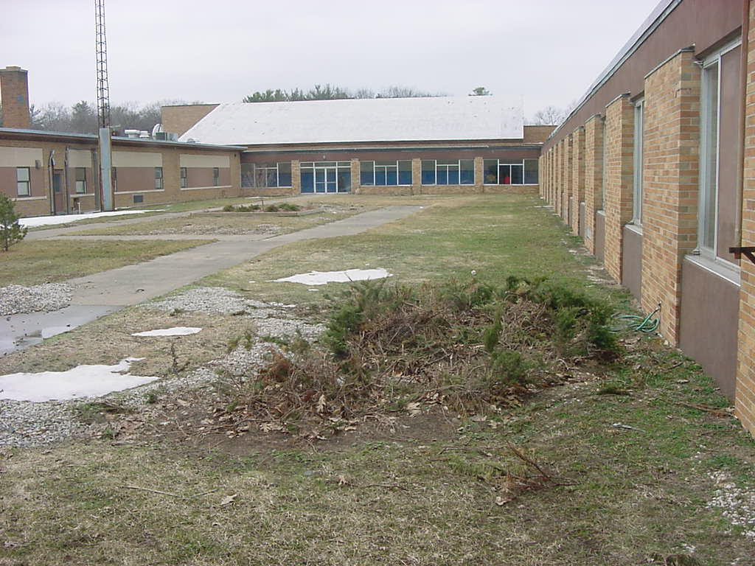
2005 Fruitport High School (the beginning)
Muskegon County
A Service Learning Project Involving Fruitport High School Student Council and Edgewood Elementary School Promoting The Use of Native Michigan Plant Species.

Slide 31
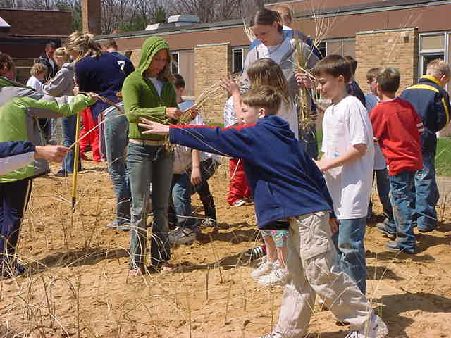
2005 Fruitport High School
Strengthen the sense of community within a school
Demonstrate hands-on methods of habitat conservation

Slide 32
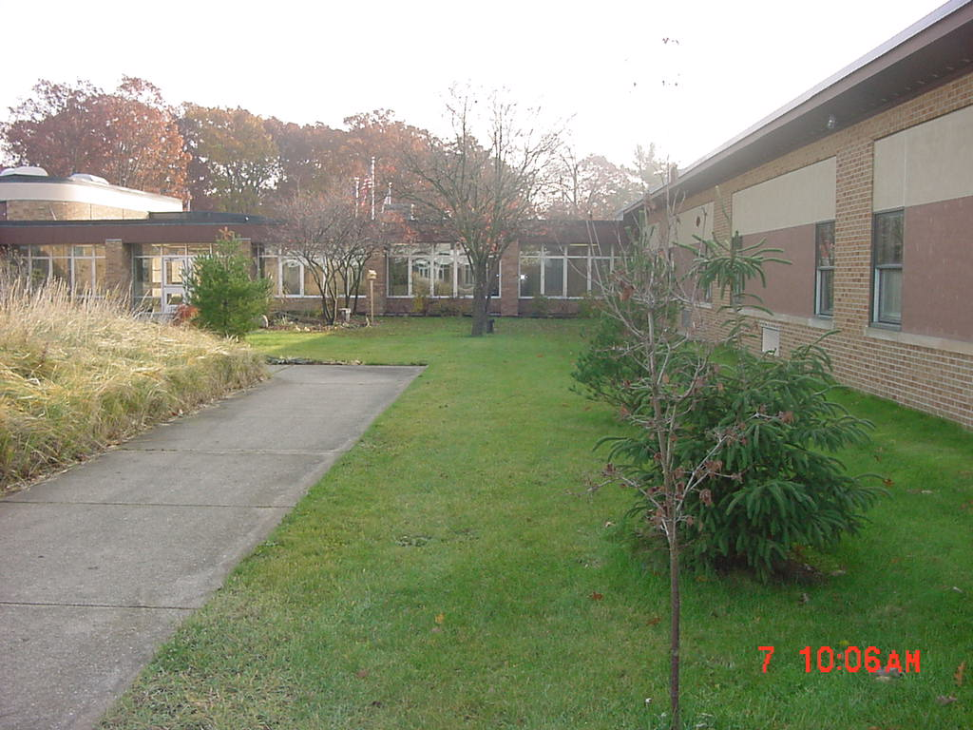
2005 Fruitport High School
Develop a teaching area that will “widen” classroom walls. Illustrate how even small changes in the landscape can make a positive difference.

Slide 33
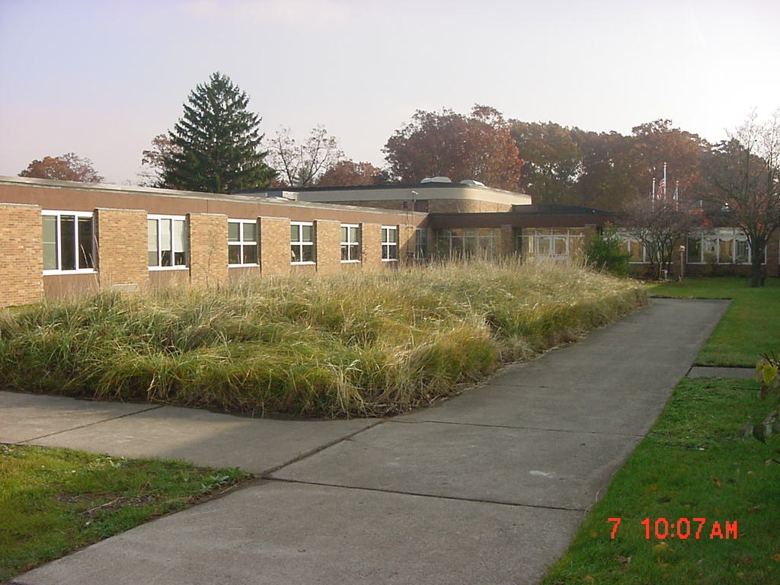
2005 Fruitport High School
Shrubs and trees provide fruits and seeds throughout the year for wildlife. Perennials provide nectar for both butterflies and hummingbirds.

Slide 34
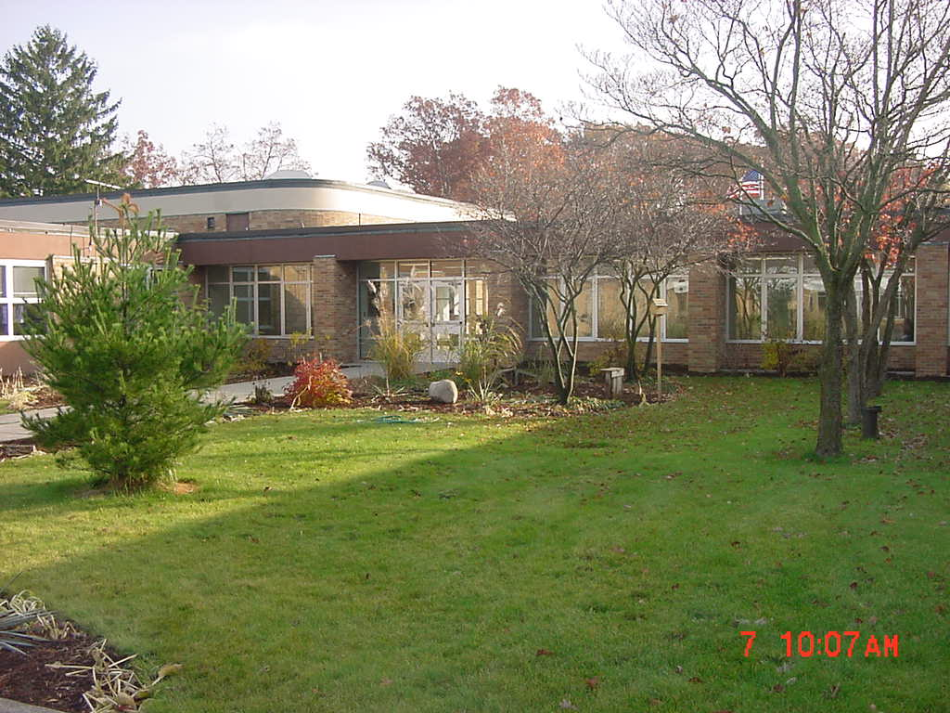
2005 Fruitport High School
Evergreen trees provide year-round protective cover from weather and predators. Deciduous shrubs offer effective summer cover for nesting and escape from predators.

Slide 35
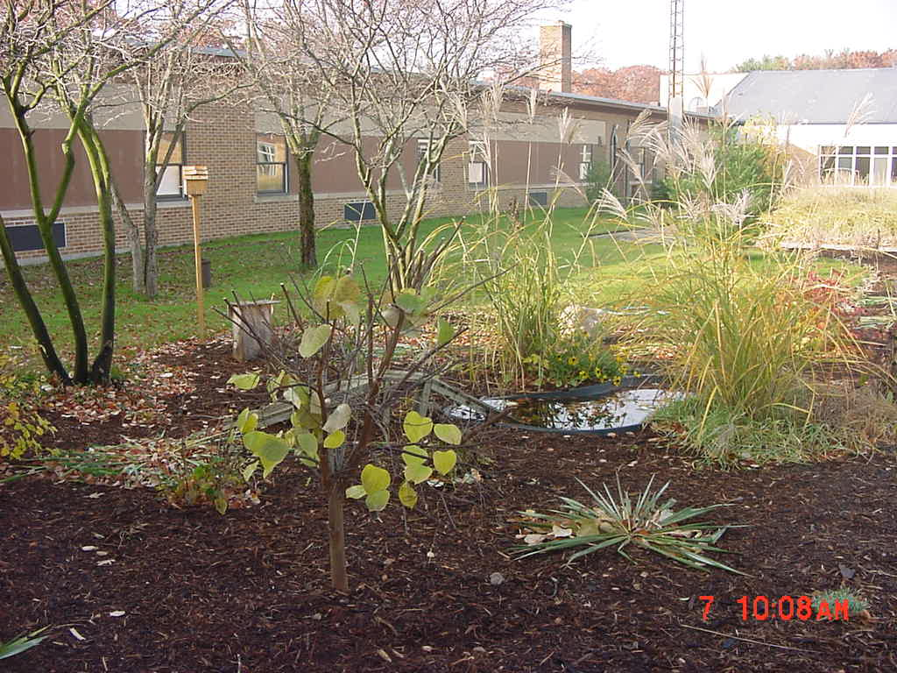
2005 Fruitport High School
Evergreens, deciduous trees, and shrubs provide nesting areas for birds.

Slide 36
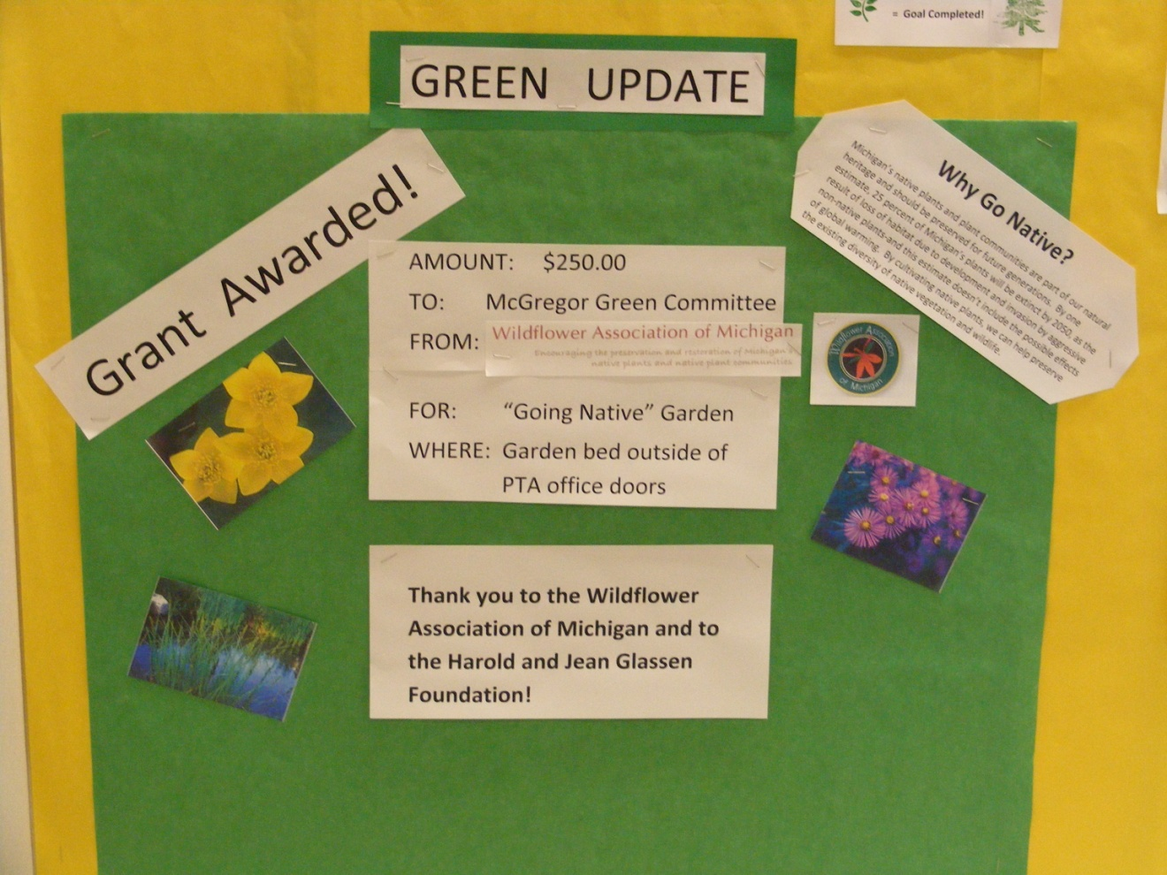
2010 McGregor Elementary
Science teachers generated interest among students in native plant gardens by expanding the criteria for our annual science fair to include research projects on native plants.

Slide 37
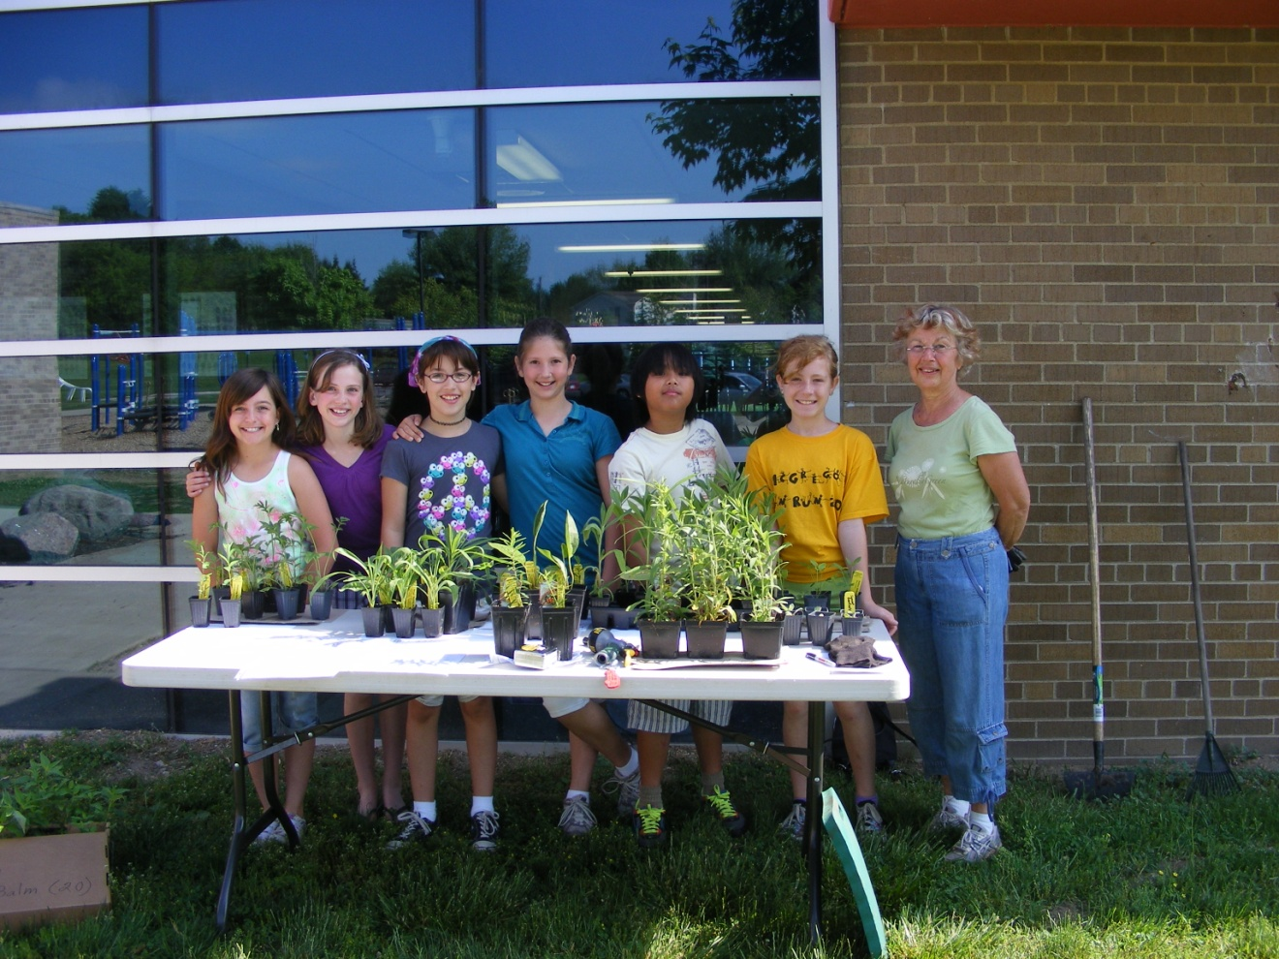
2010 McGregor Elementary
A plan was designed for a 12’ x 25’ bed, with 20 different species of forbs and grasses included a meandering path of woodchips, a feature that invites students to enter and explore.

Slide 38
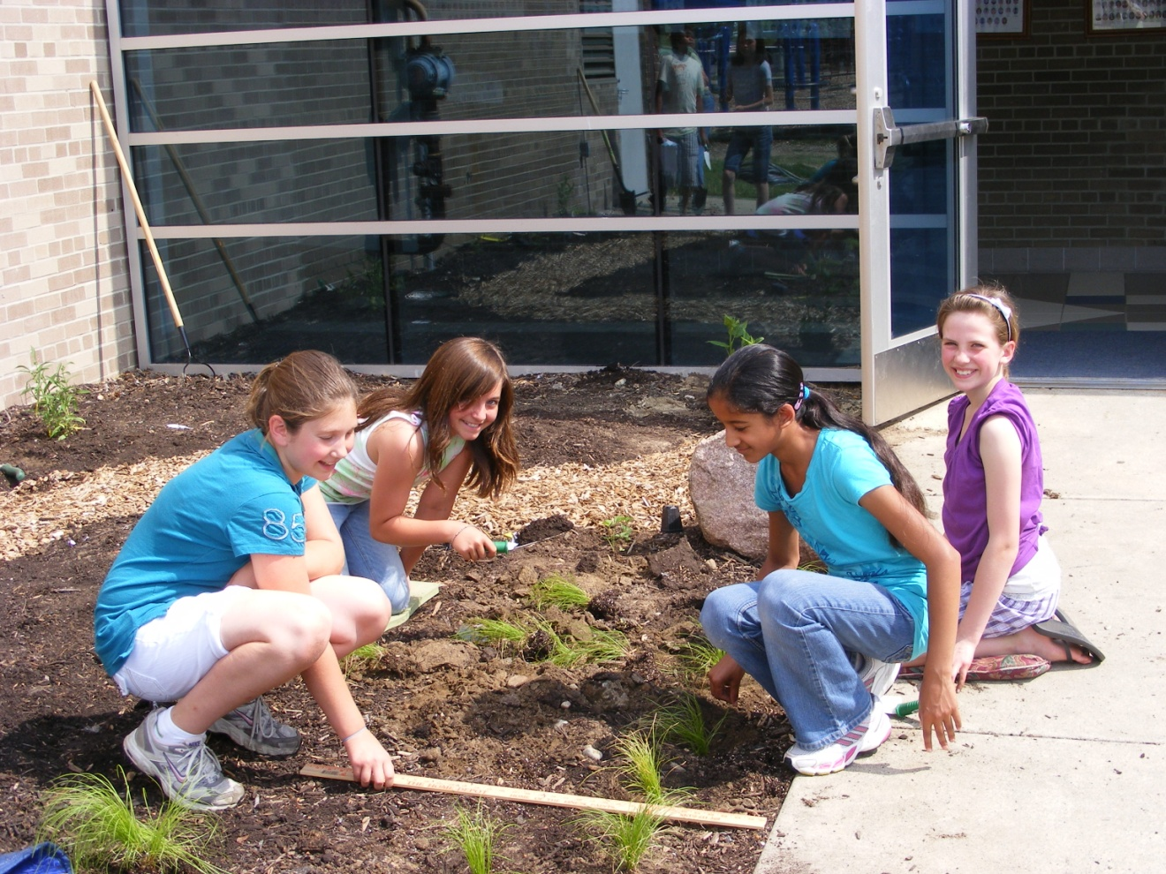
2010 McGregor Elementary
Oakland County
Paint stick signs gave scientific and common name & picture of plants to be placed in locations where the plants were to be sited. The students were eager and enthusiastic workers over the actual plants that they had researched.

Slide 39
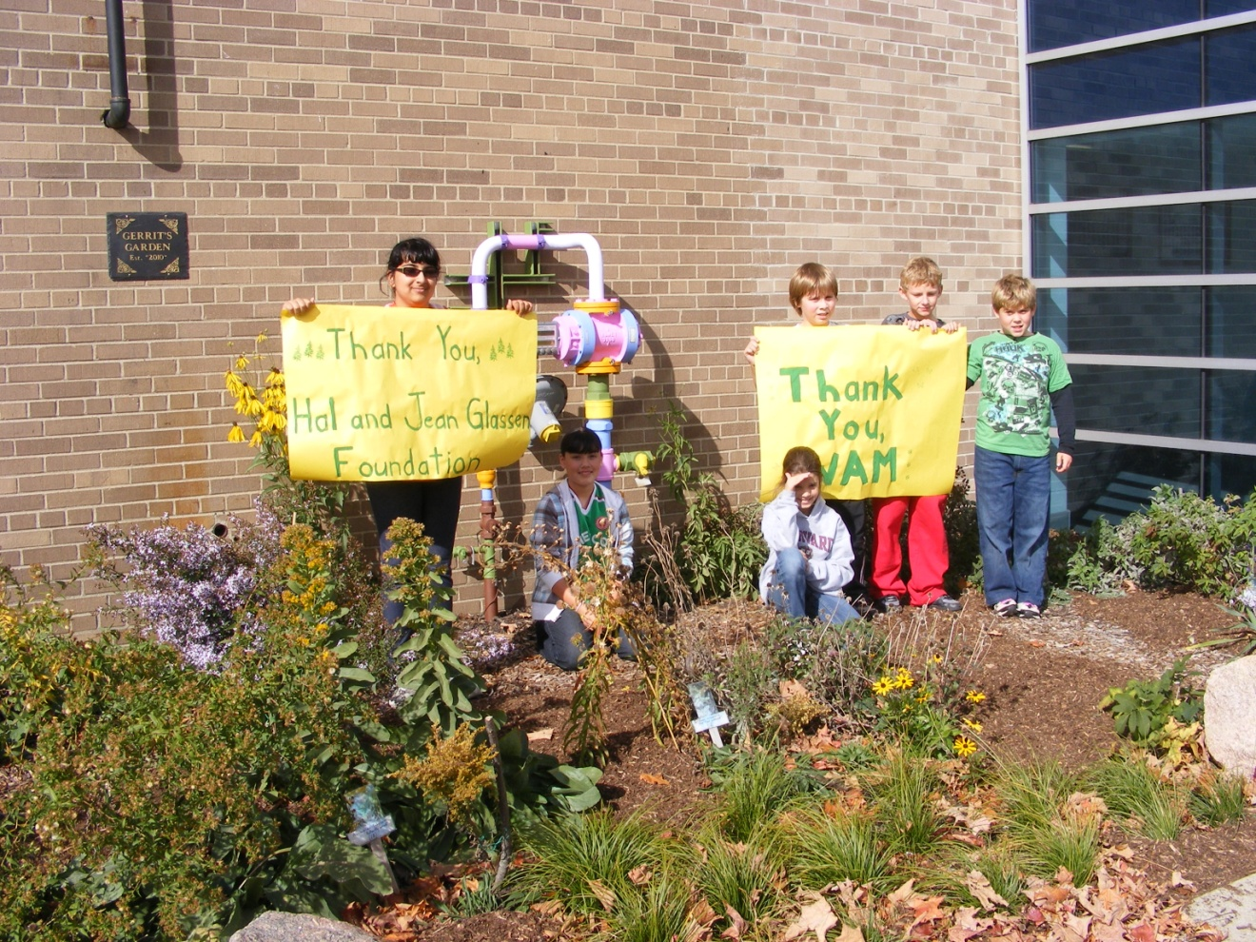
2010 McGregor Elementary
The natives thrived in hot, dry summer of 2010! Forbs grew three feet tall! The garden attracted so many bees, students called it “Beeland.” Butterflies in abundance, too. Lowe’s grant, fall 2010, created an outdoor classroom. The vegetation is all natives.

Slide 40
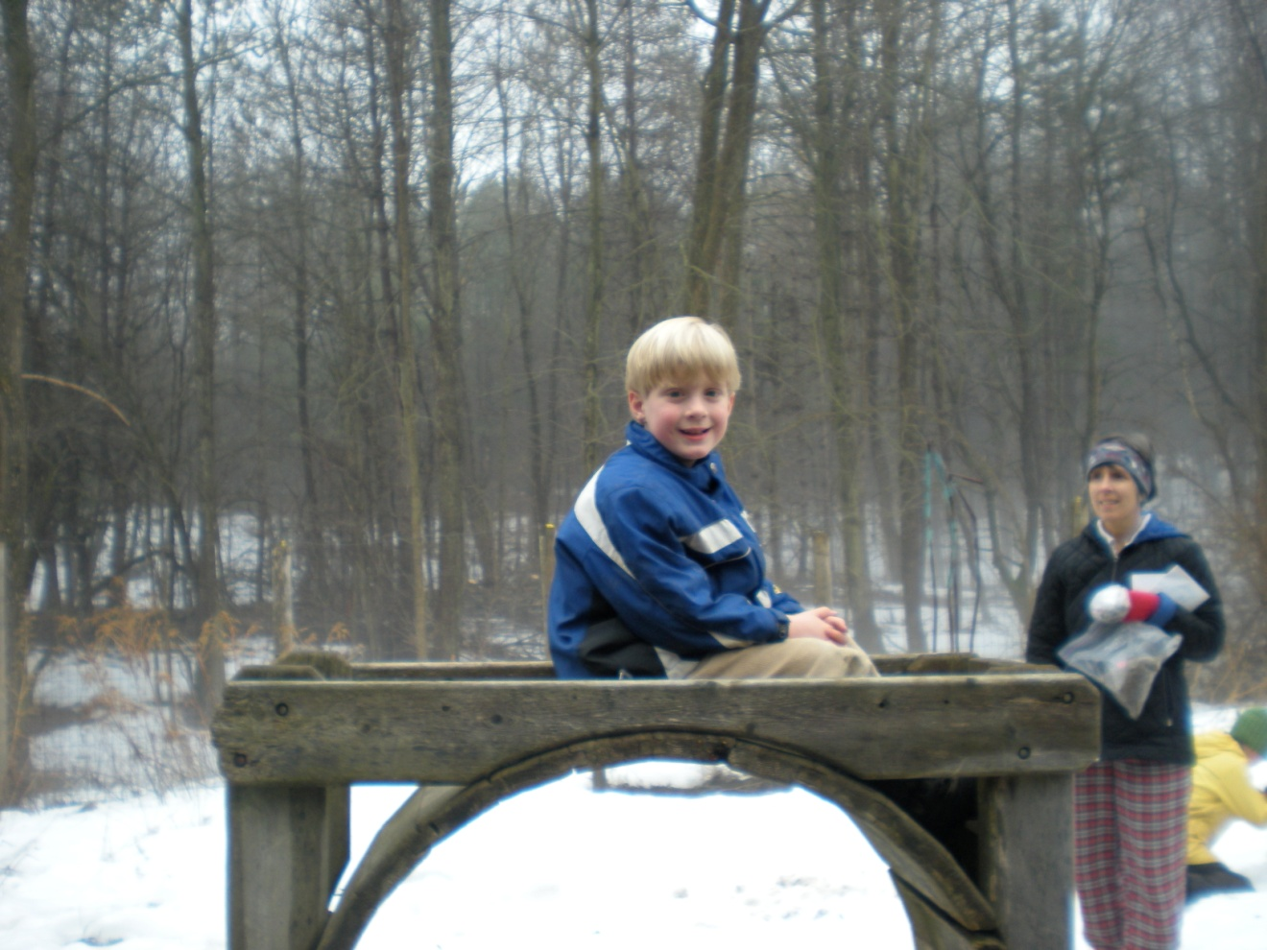
2009 – Upland Hills School
Oakland County
Minimal success was realized from plantings due to late arrival (late May) which reduced student participation. Some plants survived only to be eaten by animals. Some plants were bedded in our fenced garden area and are still being planted around school grounds.

Slide 41
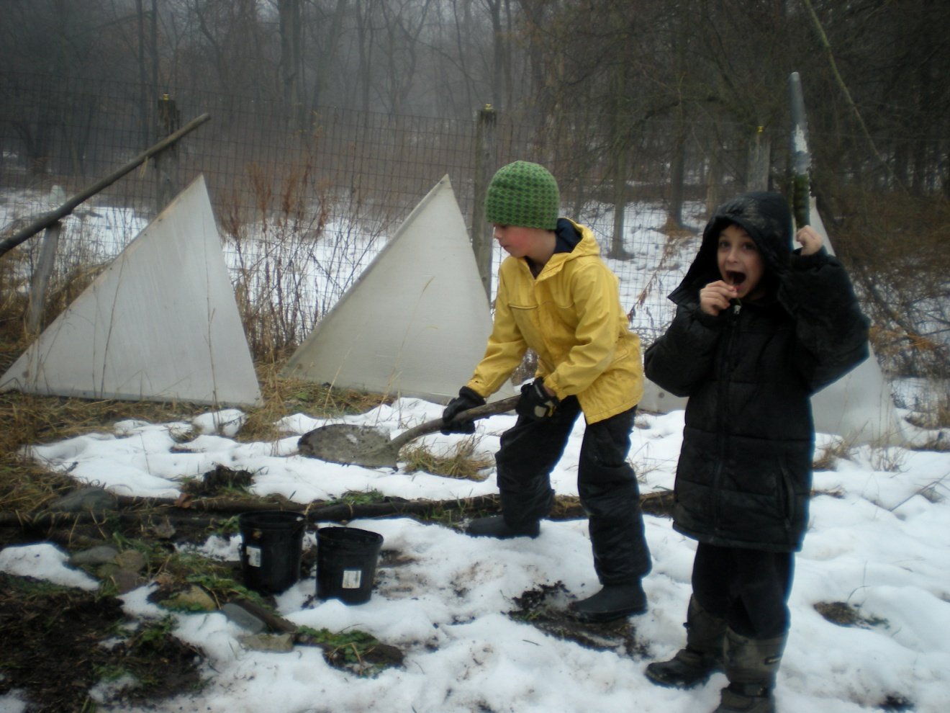
2009 – Upland Hills School
Restoration Area 1 has Big Blue Stem and Indian Grass along with Bee Balm, Cup Plant, Echinacea, & Compass Plant. We focus on growing larger colonies of certain plants and reducing invasives. Efforts include annual classes: Alien Invaders, Restoration, Bio-engineering, Gardening, Herbology, etc.

Slide 42
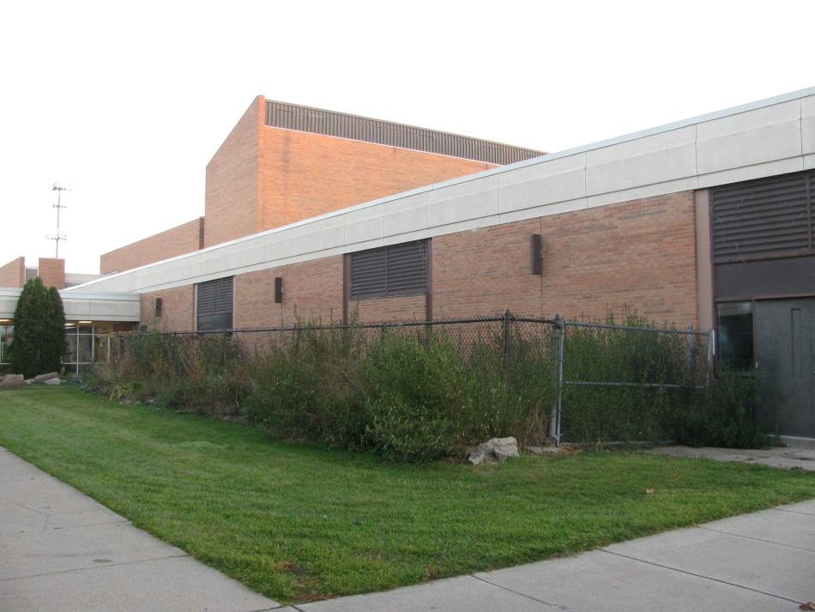
2011 – Southfield Lathrup HS
Oakland County
Before – School of 1200
Side entrance

Slide 43
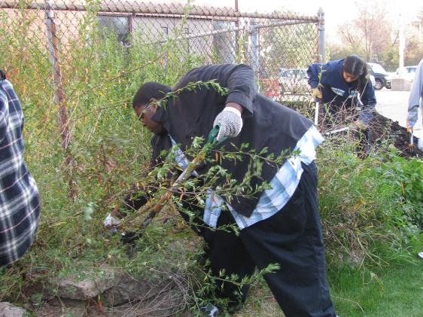
2011 – Southfield Lathrup HS
Preparing the Site

Slide 44
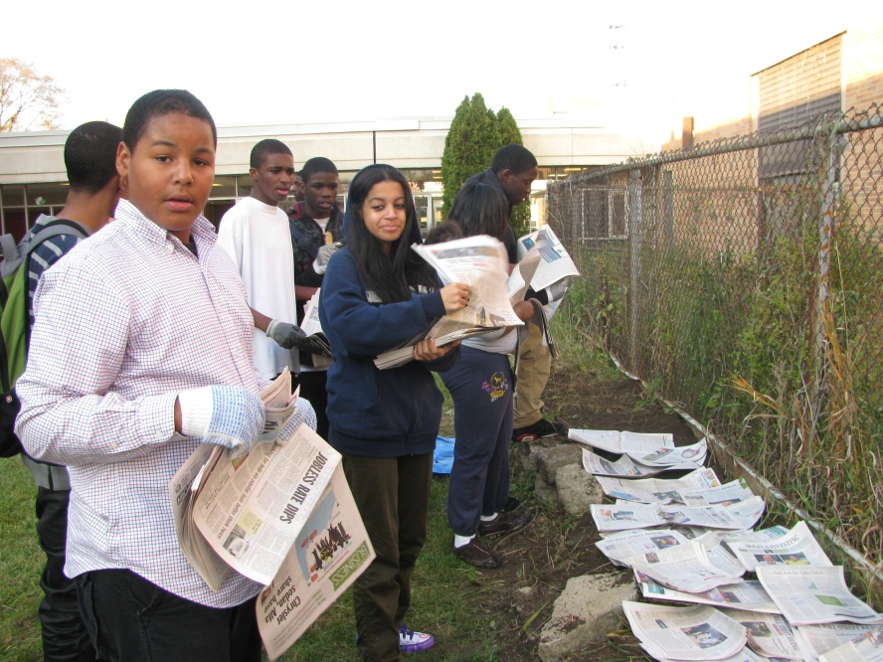
2011 – Southfield Lathrup HS
More Preparations

Slide 45
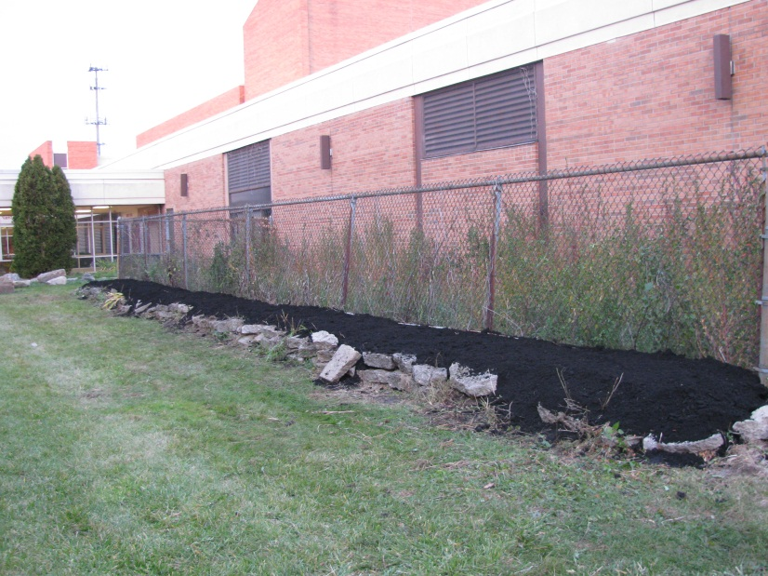
2011 – Southfield Lathrup HS
Ready for Planting

Slide 46
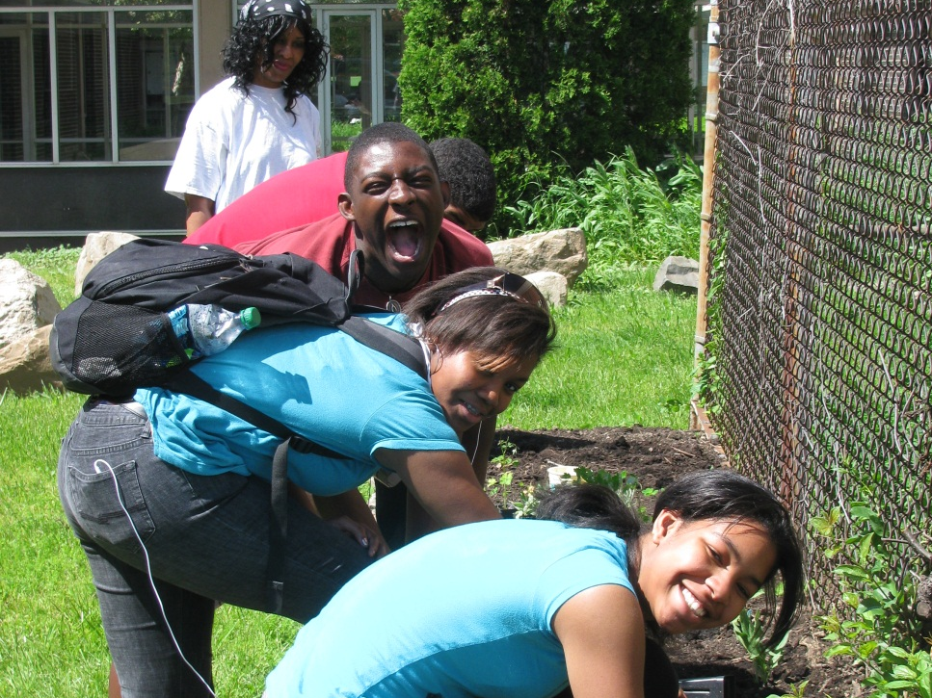
2011 – Southfield Lathrup HS
Working Together & Having Fun!

Slide 47
2011 – Southfield Lathrup HS
Planting Together

